Slide 1
NAMO NIDHI- NRI ASSET MANAGEMENT SYSTEM
Project Supervisor : Dr. CH . SARADA , Sr. Associate Professor, CSE Department
Team Members:
CHERUPALLY KAVYA(20B81A05S6)
KAYITHI VARSHITHA (20B81A05V7)
KUNTA SUPRAJA (20B81A05V1)

Slide 2
ABSTRACT
There are a lot of Non-Resident Indians(NRI’s) who are working in various countries like USA, UK, Germany etc. owing to work, study or migration. Many of them do buy a lot of assets in their home country India with a long term plan of returning to India after they retire or simply as investment options. With the exponential growth of population, there are increasing incidents of double registrations, frauds like illegal occupancy against lands purchased. In this context, the current web application is developed to offer services such as Encumbrance Certificate issue against a land from time to time,Regular Visits to the land for those NRI’s registering with this application.

Slide 3
MOTIVATION
Non-Resident Indians (NRIs) who own land or property in India often face several challenges in managing their assets .Some of the problems faced by NRIs in managing their lands in India like:
->legal issues
->lack of transparency
->difficulty in physical verification
->maintenance issues
->taxation issues and distance
Overall, NRIs face several challenges in managing their lands in India. Seeking the help of a trusted legal advisor, property management agency, or real estate agent can help NRIs manage their assets more efficiently. But for a more efficient way of managing assets we have come up with a solution of NRI asset management office (NAMO NIDHI).

Slide 4
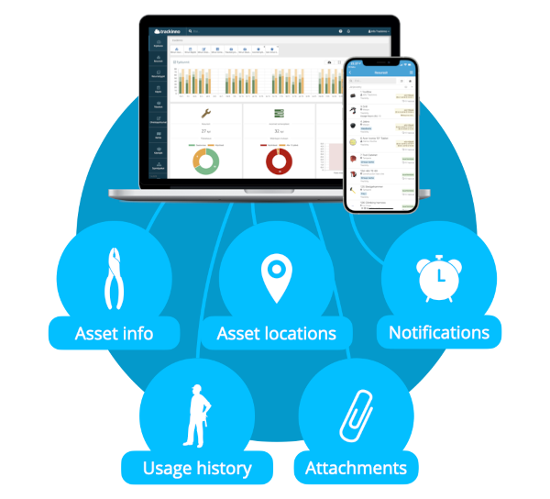
LITERATURE SURVEY
NRI-specific banking and investment platforms:
->Several banks and financial institutions offer specialized platforms for NRIs to manage their assets and investments remotely.
->These platforms provide features such as account management, portfolio tracking, and investment advisory services tailored to the needs of NRIs.
Online platforms and apps for NRI asset management:
->Various online platforms and mobile applications have been developed to help NRIs manage their assets more conveniently.

Slide 5

Financial advisory services for NRIs:
->Many financial advisory firms specialize in providing investment and wealth management services to NRIs.
->These firms offer personalized financial planning, investment advice, and portfolio management services to help NRIs optimize their asset allocation and achieve their financial goals.

Slide 6

LIMITATIONS:-
->Limited product offerings
->Complex regulatory landscape
->Currency conversion
->Limited accessibility
->Language and cultural barriers
->Lack of personalized advice

Slide 7
PROBLEM STATEMENT
NRIs face several challenges in managing their assets in India. Seeking the help of a trusted financial advisor, legal advisor, or property management agency can help NRIs manage their assets more efficiently. It is also important for NRIs to stay informed about the latest developments in the Indian market and seek professional advice before making any investment decisions .NRI’s who invest in India may face currency fluctuations, which can impact their returns. They may also face difficulties in repatriating their funds due to regulatory restrictions. If there is a trusted source on which they can rely on then it would be very helpful for them.

Slide 8
PROPOSED SOLUTION
Our Proposed Solution includes NRI’s can access our website and avail our services.
Services:- ->Regular Property Visits : The application will facilitate scheduled visits to the properties of registered NRI’s . This service helps prevent issues like illegal occupancy by ensuring that the property remains attended and properly maintained.
->Encumbrance Certificate Services: The web application will provide NRI property owners with the capability to easily obtain Encumbrance Certificate for their land holdings . This service ensures transparency and legal compliance in property transactions.

Slide 9
INTRODUTION
→Our project is useful for Non-Resident Indians (NRIs) who own land or property in India often face several challenges in managing their assets.
→Some of the challenges are: legal issues, lack of transparency, maintenance issues etc.
→This project provides services like Encumbrance Certificate, land details etc.
→ So these assets are managed by this application allows the user to monitor their lands by their own and in a very easy and quick process.

Slide 10

Technology stack
→Front-end Technologies:
HTML
CSS
JavaScript
→Back-end Technologies:
Node JS Framework
Express JS Framework
My SQL

Slide 11
Phases of development
Project Planning
Registration and Login page for user
User Database
Front-End User Interface Design and Implementation
Front-end and Back-end Integration
Land Details and Services Page
Admin Login and Pending Requests

Slide 12
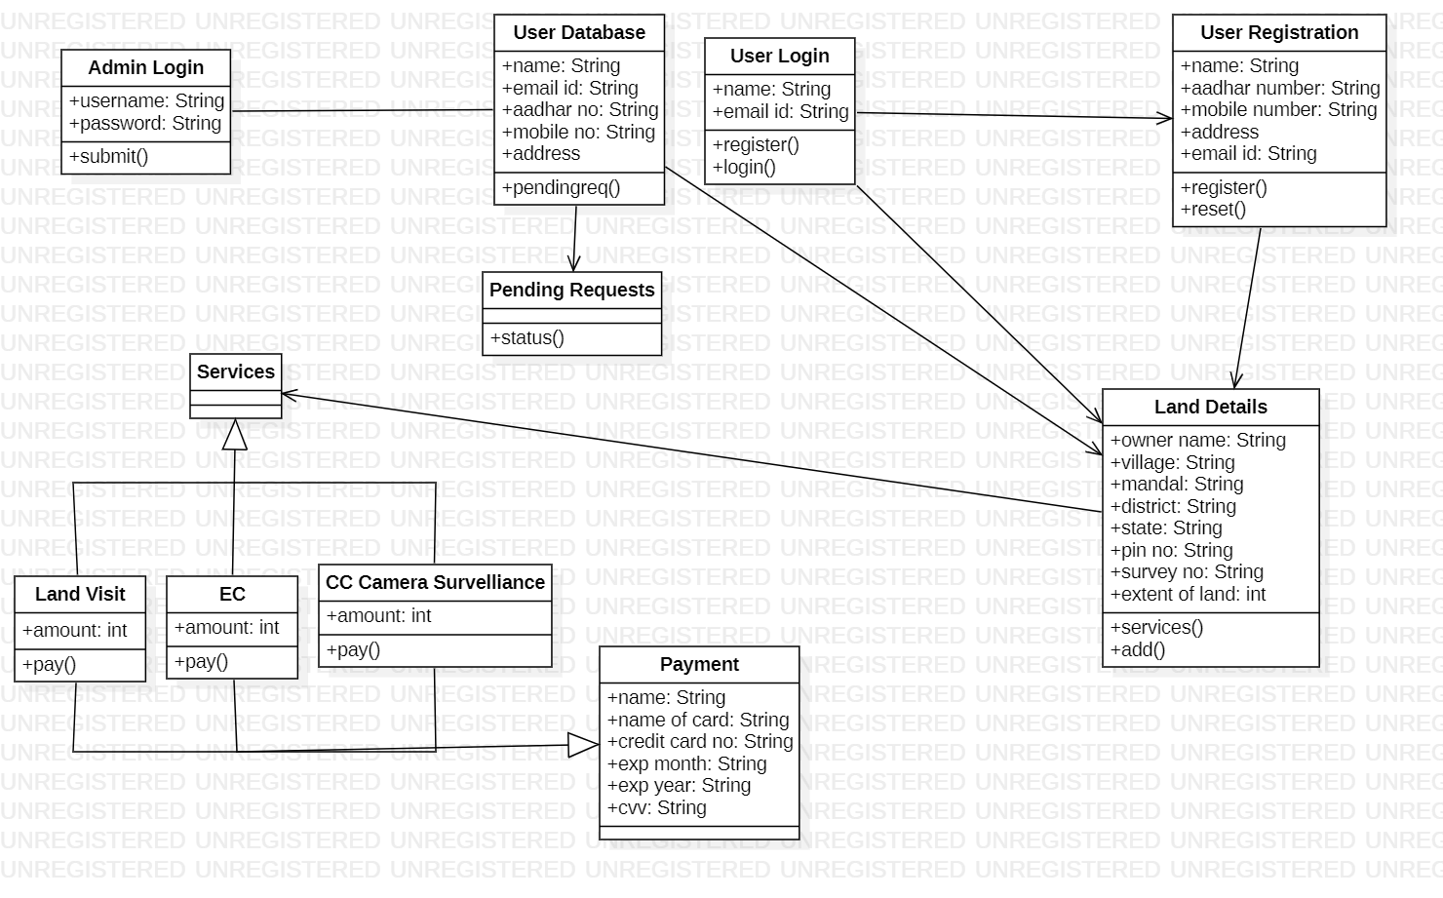
Class diagram

Slide 13
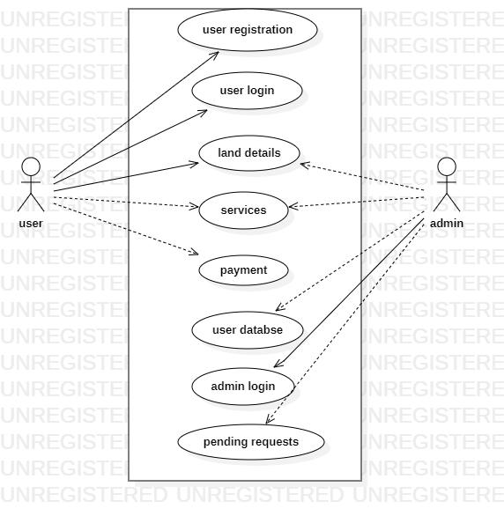
Use case diagram

Slide 14
Architecture diagram
Registration Page
SQL Database
Pending Requests
User
Land Details and Services
Back-end
Login Page
Front-end
Admin Login

Slide 15
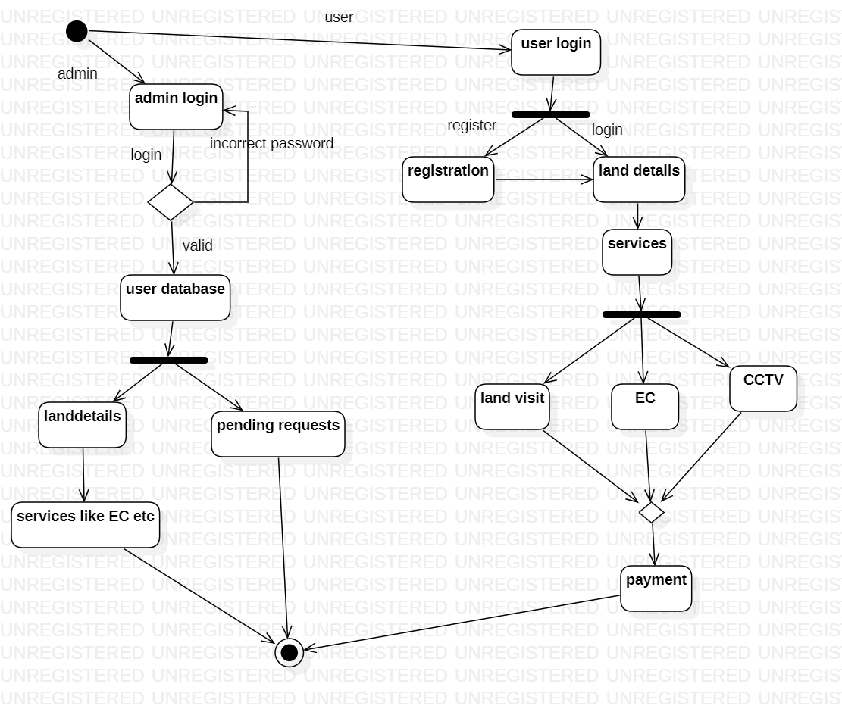
ACTIVITY DIAGRAM

Slide 16
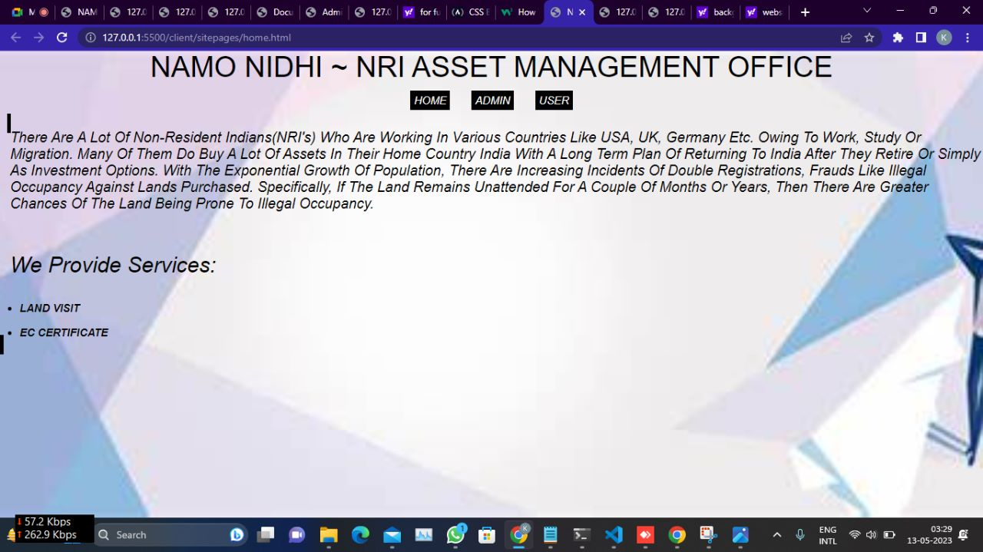
IMPLEMENTATION
HOME PAGE

Slide 17
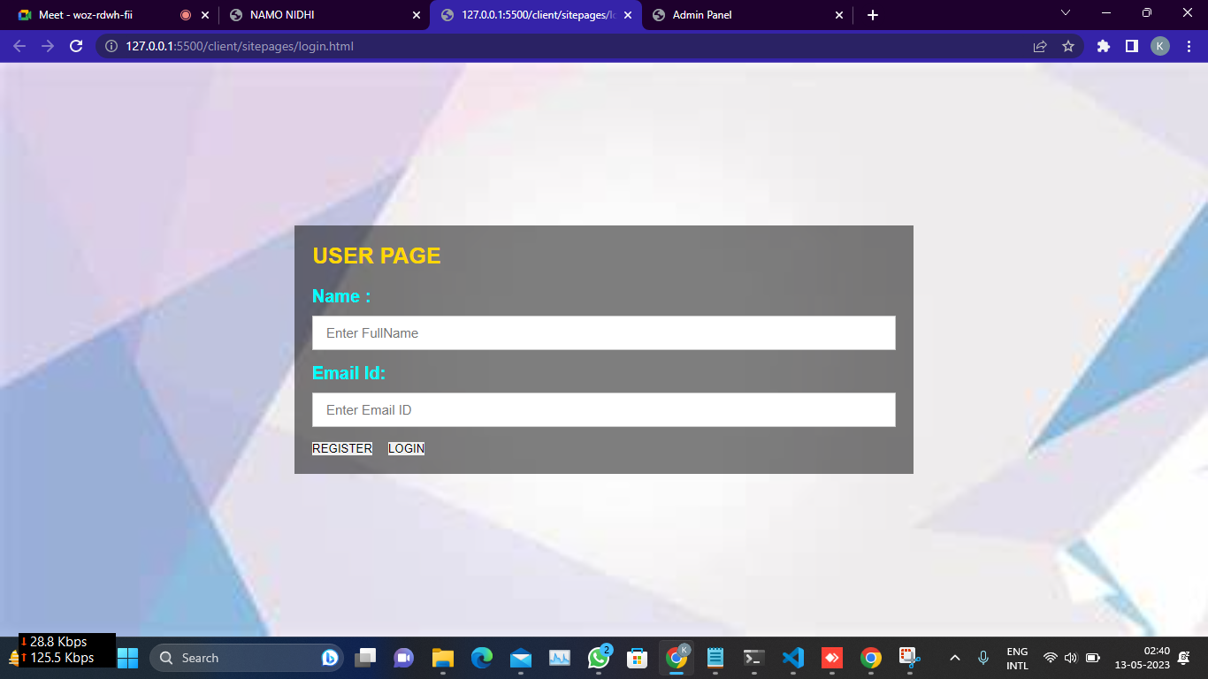
USER LOGIN PAGE

Slide 18
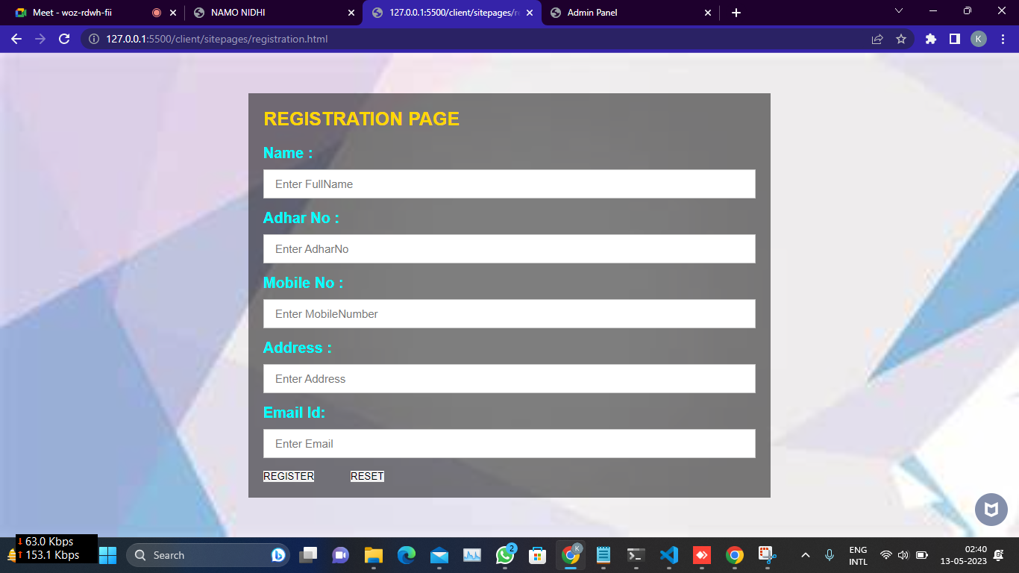
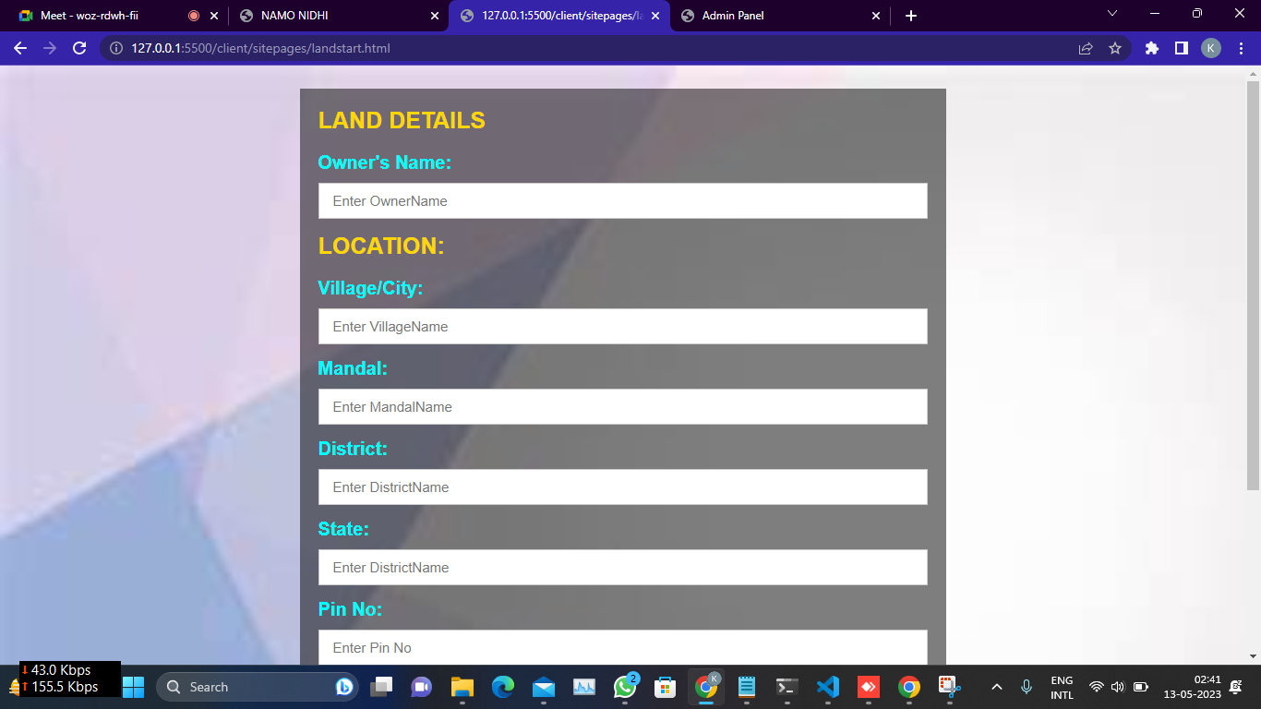
USER REGISTRATION PAGE
LAND DETAILS PAGE

Slide 19
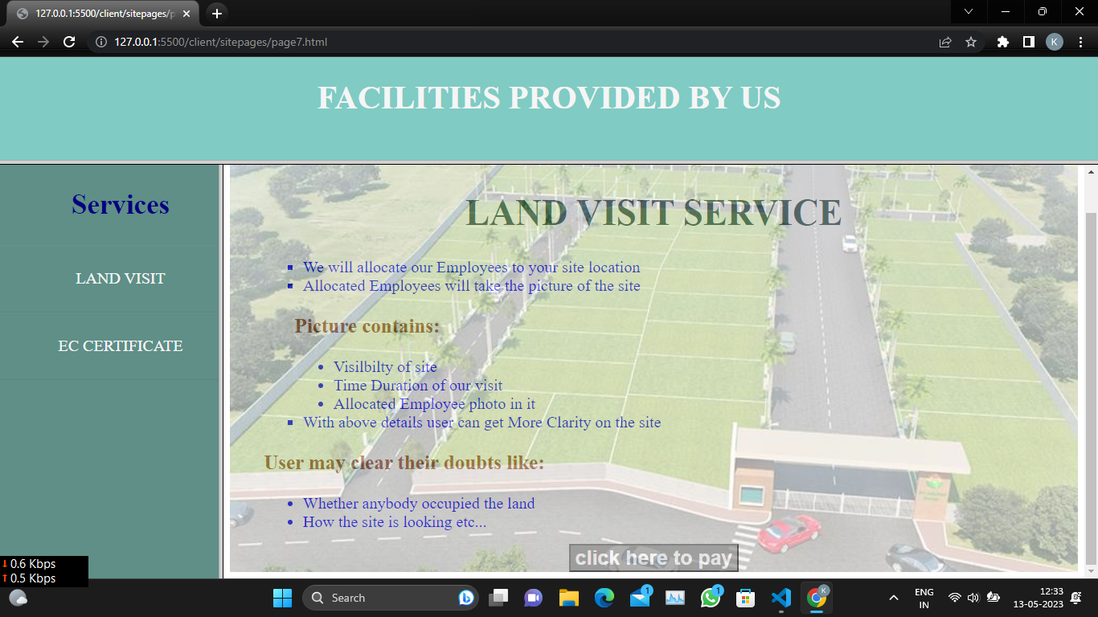
LAND VISIT PAGE

Slide 20
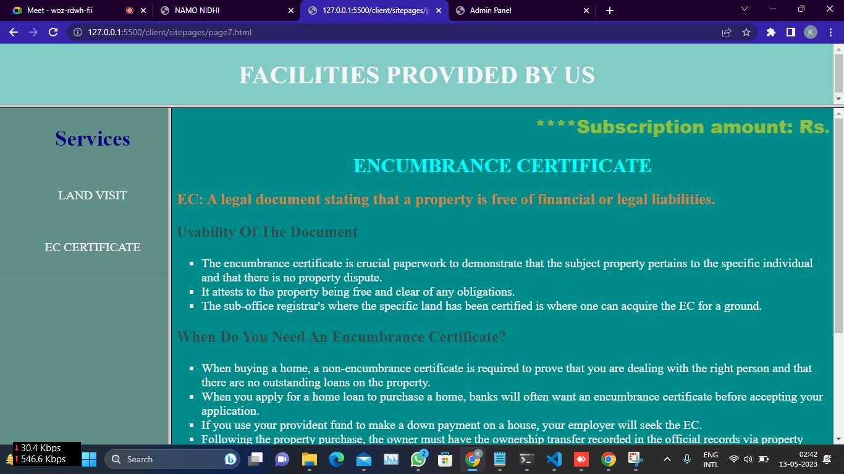
ENCUMBRANCE CERTIFICATE PAGE

Slide 21
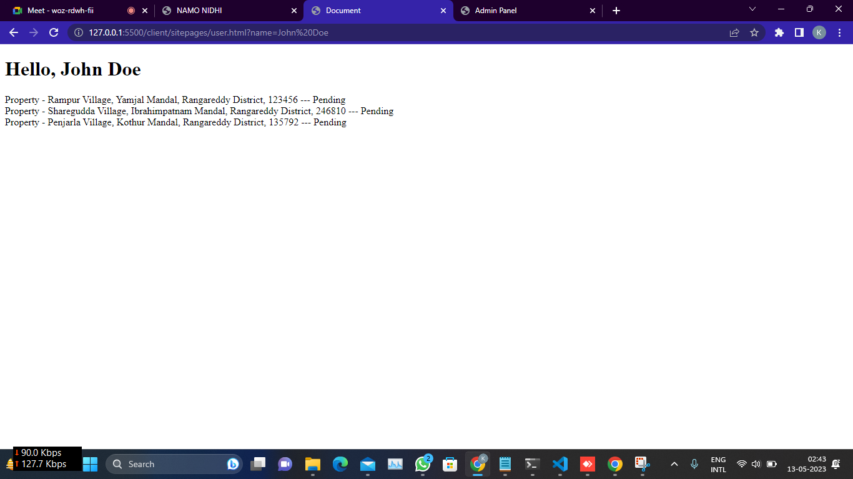
RESULTS

Slide 22
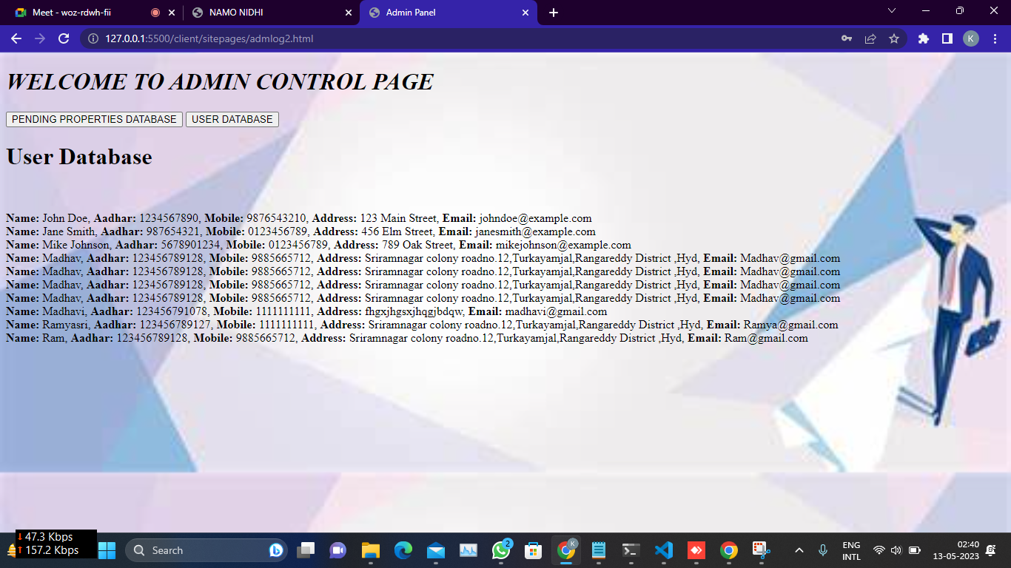
RESULTS

Slide 23
CHERUPALLY KAVYA 20B81A05S6
CONTRIBUTIONS OF STUDENTS
User Interface (UI) of Services Pages: designed the user interface for the Services, which includes : land visit , EC certificate creating the layout, visual elements, and design of the pages where NRIs will interact with the application. This is crucial for ensuring a user-friendly experience.
Backend Integration Using MySQL: Integrated the backend of the application with a MySQL database. Set up the database structure, created tables to store data, and implemented the necessary queries to retrieve and manipulate information. This is the backbone of the application.

Slide 24
KAYITHI VARSHITHA 20B81A05V7
User Interface (UI) Design: Designed the user interface for the home page, admin page, and user login page. This includes creating the layout, visual elements, and overall design for these pages, ensuring a user-friendly experience.
User Authentication: Implementing a user authentication system. This includes user registration, login, and handling authentication-related functionalities. Users, including NRIs, should have a secure and convenient way to access the application and their data.

Slide 25
KUNTA SUPRAJA 20B81A05V1
Land Registration: Designed and implemented the land registration module, allowing users to register their land details. This likely involves creating a user interface for this specific feature.
Land Details: Worked on the module that allows users to input and manage their land details. This may involve creating a user-friendly interface and ensuring the data is stored and retrieved correctly from the MySQL database.

Slide 26
CONCLUSION
- A website for NRI asset management can be an essential platform for managing the assets of Non-Resident Indians.
- The website can provide a secure and user-friendly interface for customers to view their assets, manage their accounts, and make secure transactions.
- The website can also allow administrators to manage customer accounts, monitor transactions, and provide personalized customer support.
- The website can offer online portfolio management services, allowing customers to view their assets and manage their portfolios from anywhere in the world.

Slide 27
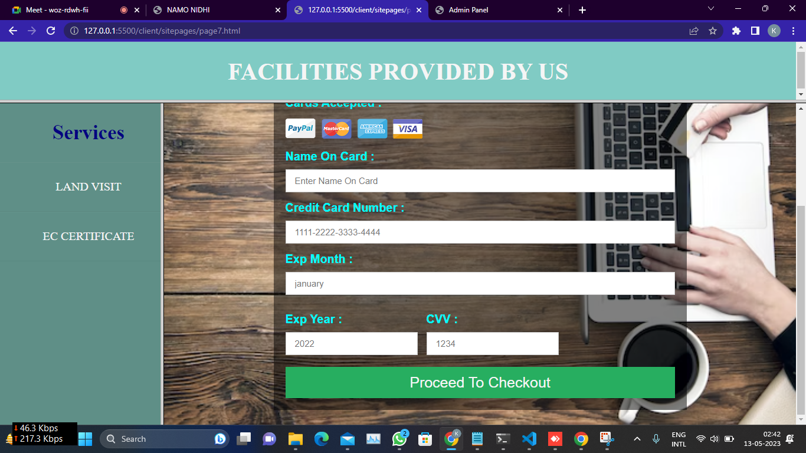
FUTURE ENHANCEMENTS
The website's features can be tailored to meet the specific needs of NRI customers, including online portfolio management, secure transactions, and personalized customer support.
Mobile Applications
Customers can make transactions using different payment methods, including wire transfer, debit/credit cards, or online payment wallets

Slide 28
REFERENCES
->Joe Mayo, “Microsoft Visual Studio 2010: A Beginner’s Guide”, Tata McGraw Hill, 2010.
->Installation – MySQL – https://www.mysql.com/
->Geeks for Geeks - https://www.geeksforgeeks.org/
->Wikipedia - https://www.wikipedia.org/
->W3 schools- https://www.w3schools.com/

Slide 29
THANK YOU

